Slide 1
DISCRETE MATHEMATICS PROJECT
By:
Hannan Mushtaq (2023-CS-85)
M Ahmad (2023-CS-69)
To:
SIR WAQAS ALI

Slide 2
CONTENTS
Graph Theory
Number Theory

Slide 3
GRAPH THEORY (QUESTION 2)
Q. Programming Tasks In Graph Theory
a. Undirected Graph Degrees
b. Directed Graph Degrees
c. Bipartite Graph Check
d. Adjacency Matrix Creation
e. Edge Listing From Adjacency Matrix
f. Incidence Matrix Creation

Slide 4
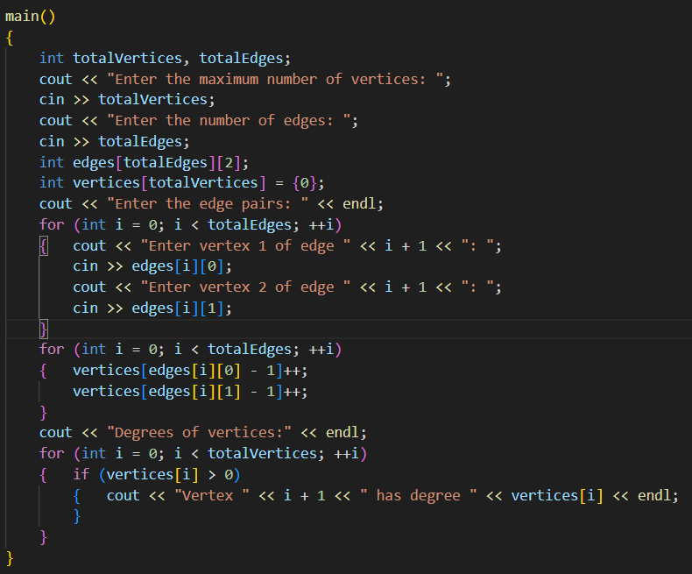
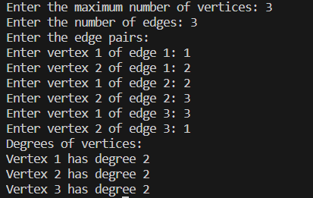
A. UNDIRECTED GRAPH DEGREES
OUTPUT:

Slide 5
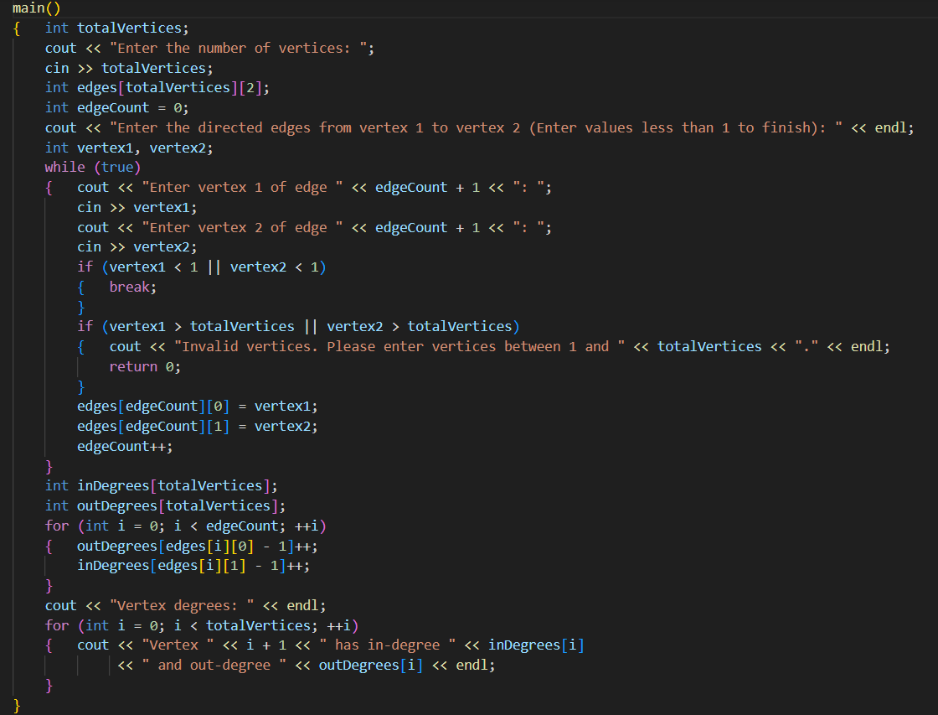
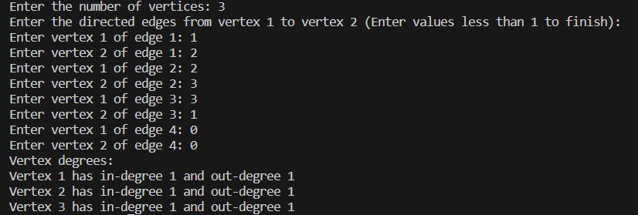
B. DIRECTED GRAPH DEGREES
OUTPUT:

Slide 6
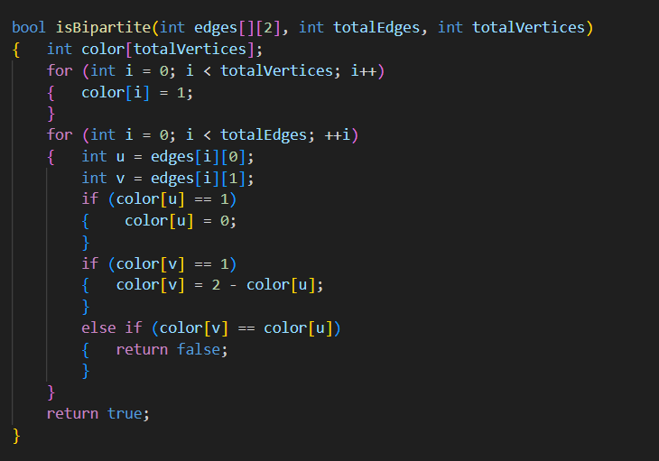
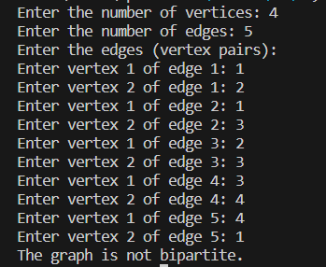
C. BIPARTITE GRAPH CHECK
OUTPUT:

Slide 7
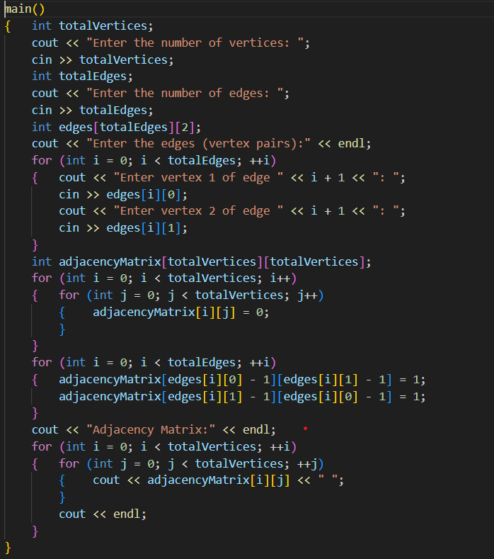
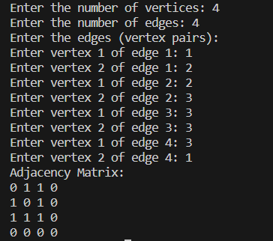
D. ADJACENCY MATRIX CREATION
OUTPUT:

Slide 8
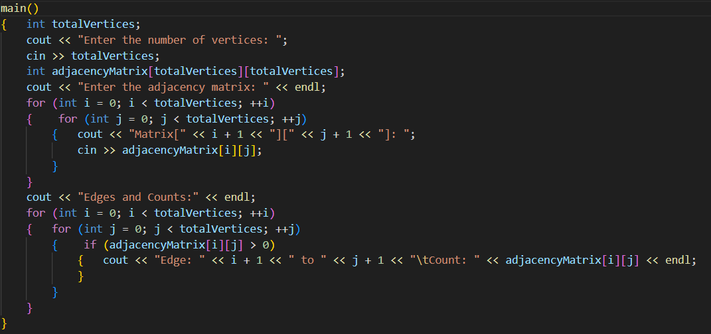
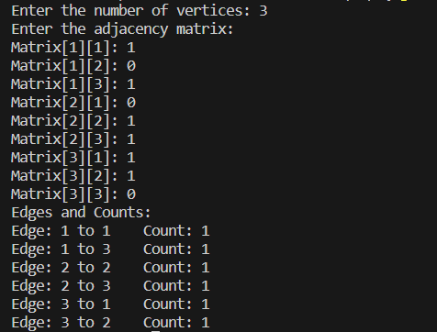
E. EDGE LISTING FROM ADJACENCY MATRIX
OUTPUT:

Slide 9
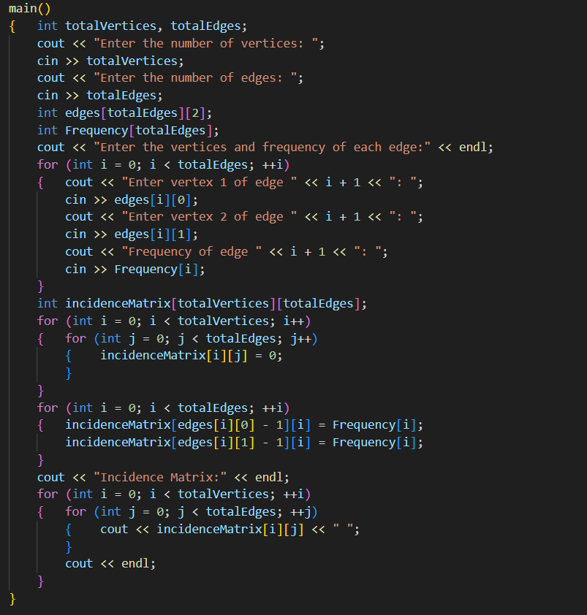
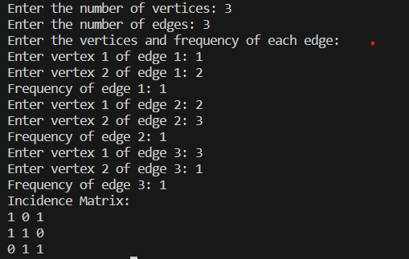
F. INCIDENCE MATRIX CREATION
OUTPUT:

Slide 10
CONCLUSION
That was all from my side. Make sure to check out my partner
Muhammad Ahmad’s LinkedIn for the rest of the project’s
video demonstration.

Slide 11
THE END! THANKS!

